Slide 1
Phagocytosis and
Intracellular Killing

Slide 2
Defination
Phagocytosis:
  An Evolutionarily Conserved Mechanism to Remove Apoptotic Bodies and Microbial Pathogens

Slide 3
Phagocytes
Cells that protect the body by ingesting harmful foreign particles- bacteria, and dead or dying cells
Neutrophils
Monocytes
Macrophages
Dendritic cells
Mast cells

Slide 4
Professional Phagocytes
location | Variety of phenotypes
Blood | neutrophils, monocytes
Bone marrow | macrophages, monocytes, sinusoidal cells, lining cells
Bone tissue | osteoclasts
Gut and intestinal Peyer's patches | macrophages
Connective tissue | histiocytes, macrophages, monocytes, dendritic cells
Liver | Kupffer cells, monocytes
Lung | self-replicating macrophages, monocytes, mast cells, dendritic cells
Lymphoid tissue | free and fixed macrophages and monocytes, dendritic cells
Nervous tissue | microglial cells (CD4⁺)
Spleen | free and fixed macrophages, monocytes, sinusoidal cells
Thymus | free and fixed macrophages and monocytes
Skin | resident Langerhans cells, other dendritic cells, conventional macrophages, mast cells

Slide 5
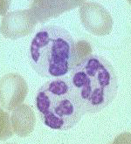
Phagocytes - Neutrophils (PNMs)
Characteristic nucleus, cytoplasm
Granules
CD 66 membrane marker

Slide 6
Characteristics of Neutrophil Granules
primary granules
secondary granules
azurophilic; characteristic of young neutrophils;
specific for mature neutrophils
contain cationic proteins, lysozyme, defensins, elastase and
myeloperoxidase
contain lysozyme, NADPH oxidase components, lactoferrin and B12-binding protein

Slide 7
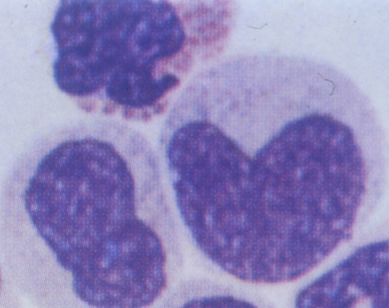
Phagocytes - Macrophages
Characteristic nucleus
Lysosomes
CD14 membrane marker

Slide 8
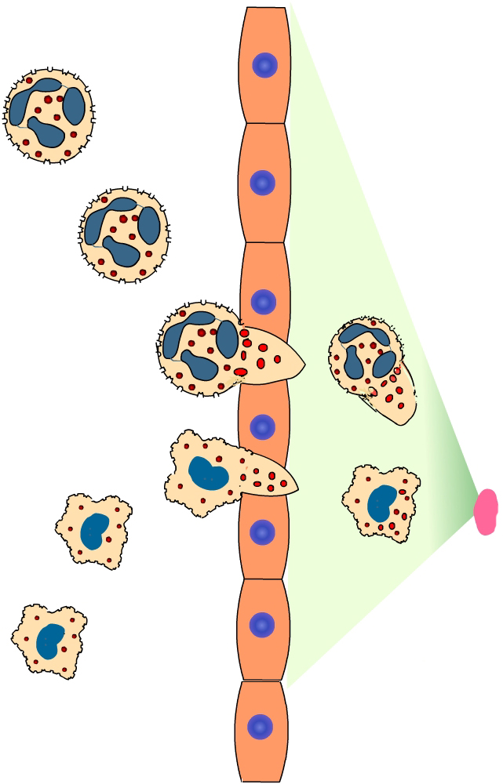
Phagocyte Response to Infection
The SOS Signals
  N-formyl methionine-containing peptides
  Clotting system peptides
  Complement products
  Cytokines released by tissue macrophages
Phagocyte response
  Vascular adherence
  Diapedesis
  Chemotaxis
  Activation
  Phagocytosis and killing

Slide 9

Initiation of Phagocytosis
Attachment via Receptors:
IgG FcR
Complement R
ScavengerR
Toll-like R

Slide 10
Cellular Barriers Phagocytosis
carried out by 2 types of leukocytes in the blood:
  neutrophils, a type of granulocyte (60-70%)
  monocytes, a type of agranulocyte (3-8%)
phagocytes in the body can be divided into 2 types:
  microphages (e.g., neutrophils) - phagocytic against bacteria in the early phases of infection
  macrophages - fixed in tissues (reticuloendothelial system); active against microbes, dead and dying microphages, dead tissue

Slide 11
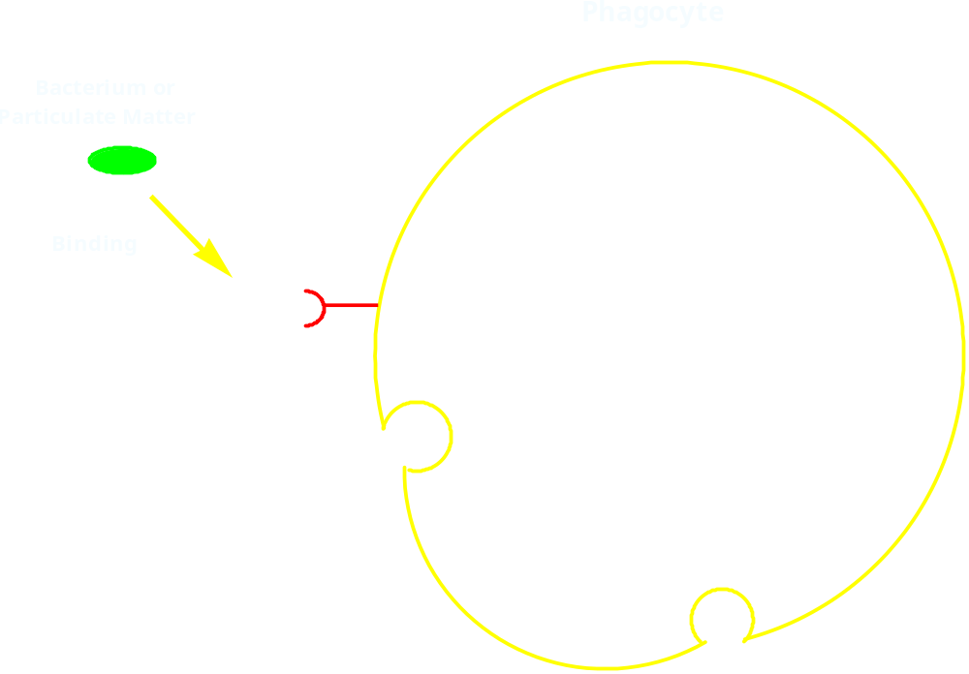
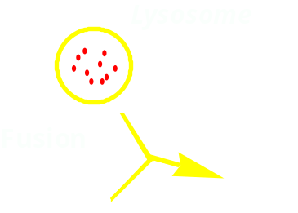
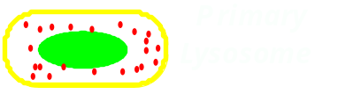

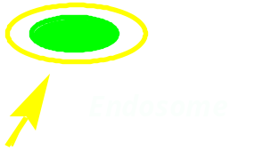
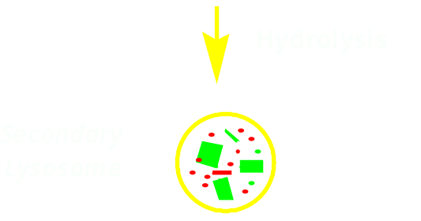


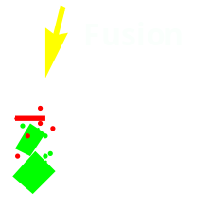
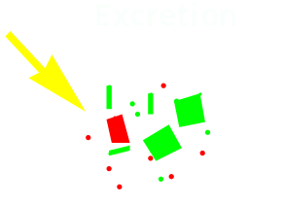
Phagocytosis

Slide 12
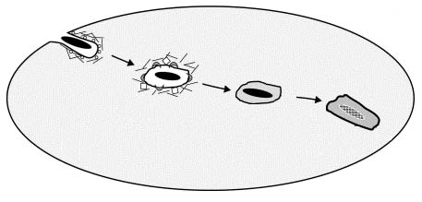
Post-phagocytic Events
Pathogen
Macrophage
2O₂ ⎯⎯⎯⎯⎯⎯⎯⎯→ 2O₂⁻ + H⁺
NADPH oxidase
2O₂⁻ + NO• ⎯⎯→ ONOO⁻
Peroxynitrite
H₂O₂ + Cl⁻ ⎯⎯⎯⎯⎯⎯⎯⎯→ HOCl + OH•
Myeloperoxidase
O₂•⁻ + O₂•⁻ + 2H⁺ ⎯⎯⎯⎯⎯⎯⎯⎯⎯⎯⎯→ H₂O₂ + O₂
Superoxide dismutase
Phagosome-Oxidase Fusion
Generation of H₂O₂
Myeloperoxidase Activity
Peroxynitrite Production

Slide 13
Mechanisms to avoid destruction by phagocytes
kill the phagocyte
inhibit binding or endocytosis
overwhelm phagocytes
resistance to digestion in the phagolysosome,e.g., TB, leprosy, leishmaniasis

Slide 14
Immunological Consequences
of Phagocytosis
Clearance of pathogens
Death of pathogenic microbe Persistence of pathogenic microbe
Resolution of infection Failure of resolution of infection
Clearance of apoptotic corpses
Suppression of inflammation Inappropriate inflammation
Tolerance Break in tolerance

Slide 15
Bacterial Virulence Factors Subvert Host Defenses
Modification of
phagocytic receptors
(P. aeruginosa)
Escape from phagosome
into cytosol (Listeria, Shigella)
Ingestion phase
impaired
(Yersinia)
Phagosome
maturation stalled
(M. tuberculosis; Legionella)
Resistance to
lysosomal degradation
(Salmonella)

Slide 16
Functions of Phagocytosis
clear the body of debris
secrete defense proteins, e.g., interferon
ingest and kill bacteria
inflammation - synthesize endogenous pyrogen (IL-1)
antigen processing

